Slide 1
Neural Networks in heart disease detection
Rajesh thomas (rr15f) Sourindu chatterjee (sc15)

Slide 2
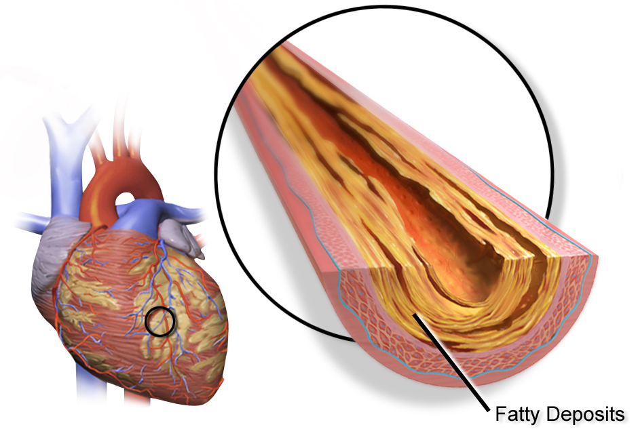
Introduction
Heart supplies blood to different parts of body
Heart is a muscle (myocardium), so it itself needs blood to function
Arteries that carry blood to the myocardium are called coronary arteries.
Coronary arteries can get blocked, in general called Coronary Heart Disease (CHD)

Slide 3
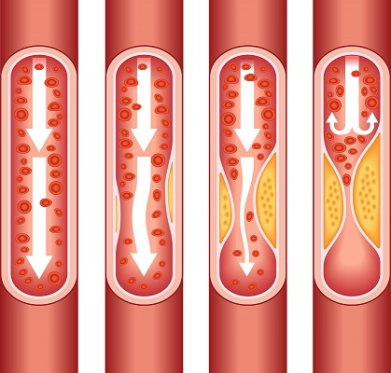
Motivation
About 610,000 people die in the United States due to heart diseases every year.
That’s about 1 in every 4 deaths
Coronary Heart Disease (CHD) is the most common type of heart disease.
CHD causes more than 370,000 deaths annually.
Modern Machine Learning algorithms, combined with powerful hardware have become sophisticated enough to aid CHD detection.

Slide 4
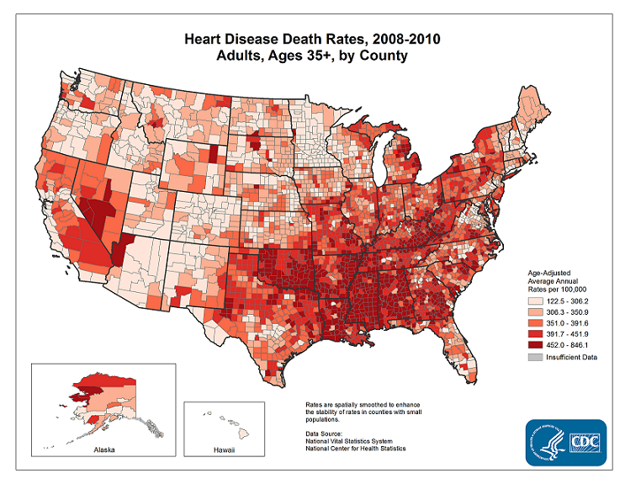


Slide 5
Project goals
Predict if a patient will get heart disease or not using the UCI database
Compare the performance of different algorithms
Algorithms used are K-Nearest Neighbor, Backpropagation, Decision Tree and Radial Basis Function.

Slide 6
UCI Database
Very comprehensive database which contains data from different parts of the world.
Provides many attributes which records many parameters that checks the health of the heart
Provides ample number of samples

Slide 7
CHD
Age
Chest Pain Type (4 types considered)
Resting Blood Pressure
Cholesterol
Blood Sugar
Resting ECG
Maximum Heart Rate
Exercise Induced Angina (chest pain)
ST Depression Induced by Exercise
Gender

Slide 8
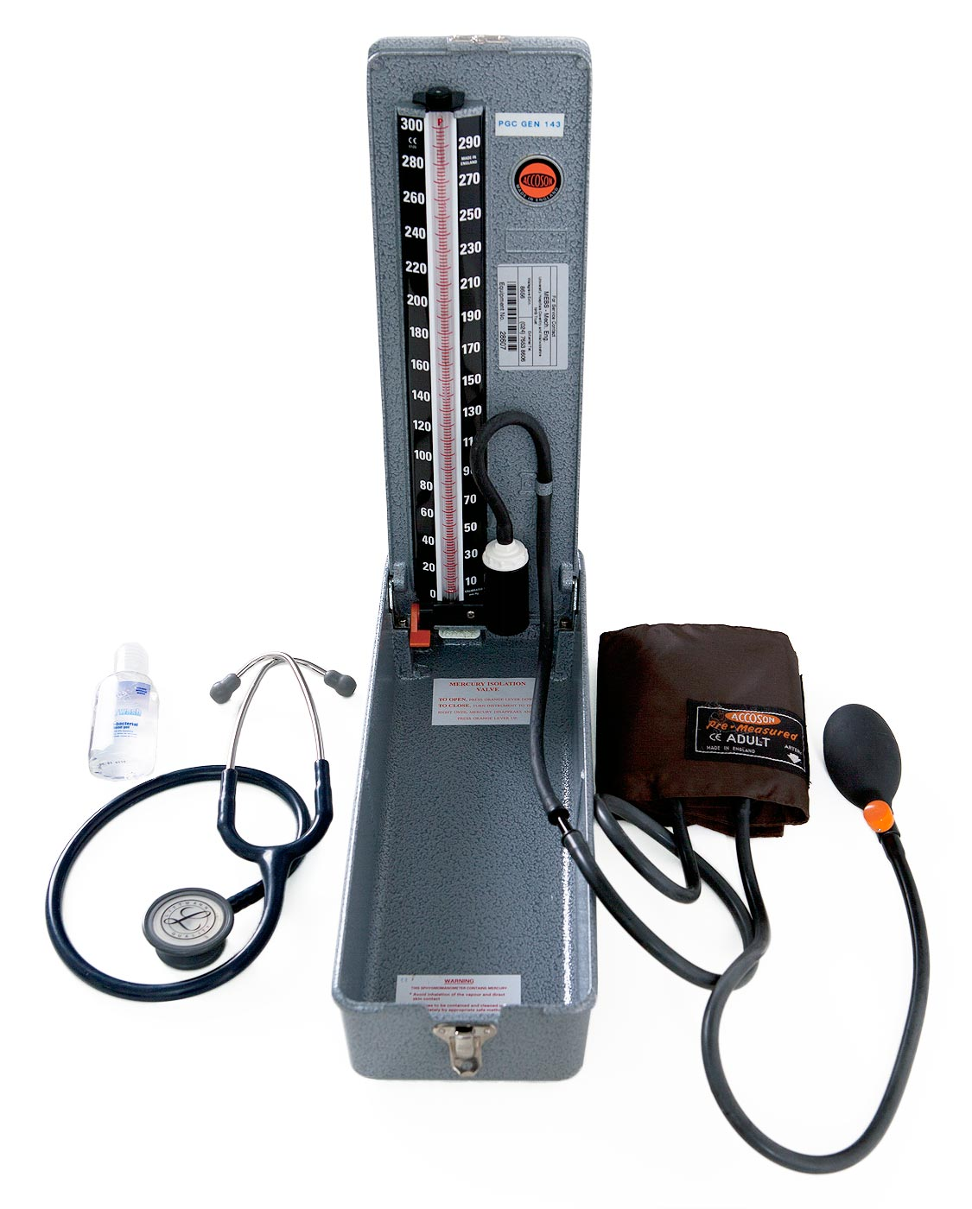
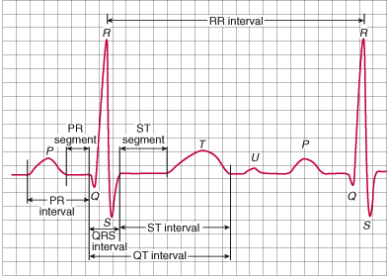
sphygmomanometer

Slide 9
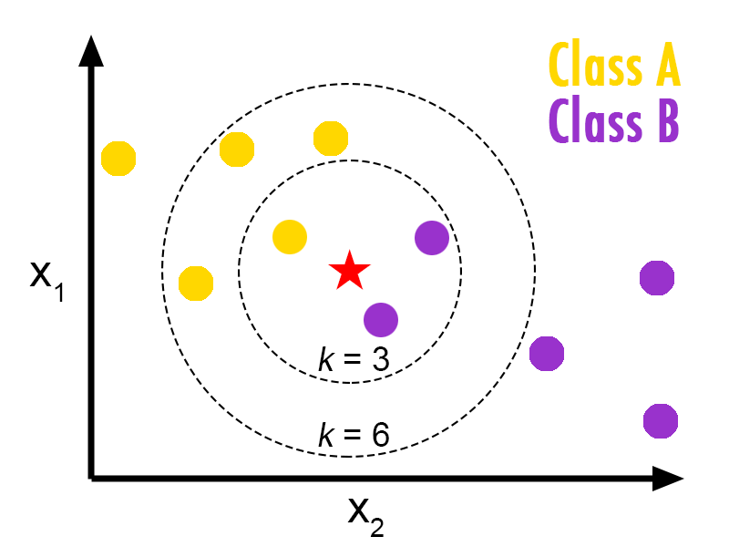
K-Nearest Neighbor
Find the number of k nearest values corresponding to the new observation.
Find which attribute has the maximum frequency among them.
The predicted output will be the one with the maximum frequency
The algorithm optimizes the value of k and the distance function to give the best results.

Slide 10
KNN Optimization Graphs

Slide 11
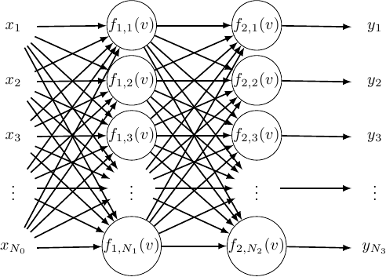
BackPropagation ALGORITHM
This was developed by Werbos, Parker & Rumelhart and is the heart of modern day NN.
The Multi-Layer Feed-Forward Network is effectively trained using Backpropagation Algorithm.
Calculates the gradient of a error function e.g MSE, with respect to the weights in the network.
The gradient is used to update the weights so that the error function is minimized.
Outputs are calculated in both the layers using Sigmoid function.

Slide 12
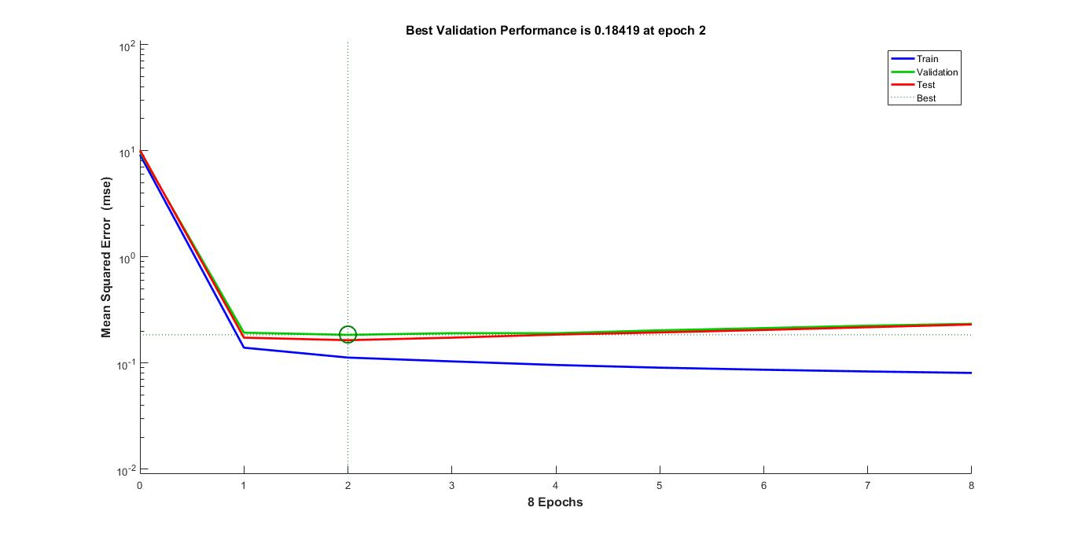
Backpropagation Training

Slide 13
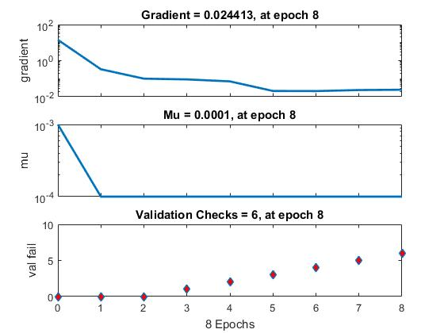
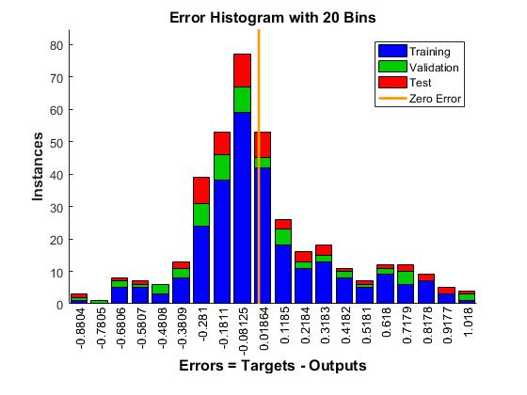
Backpropagation Training

Slide 14
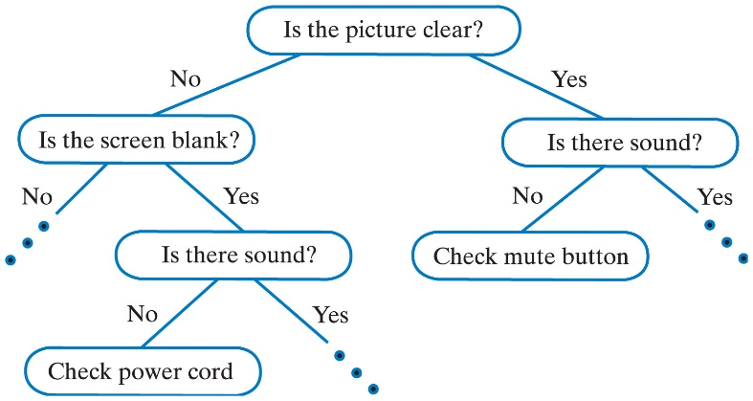
Decision Tree
Decision support tool with a flowchart like structure
Traditionally created using hand
Grow a decision tree based on the input values and a desired cost function like Entropy.
Cross check with testing data

Slide 15
Tree optimization

Slide 16
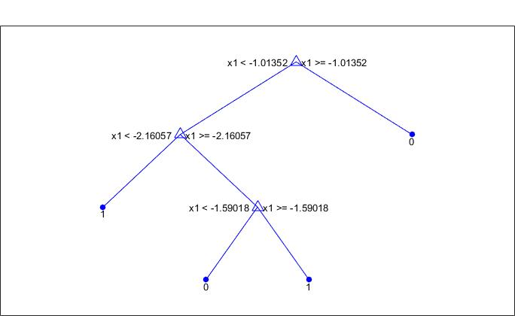
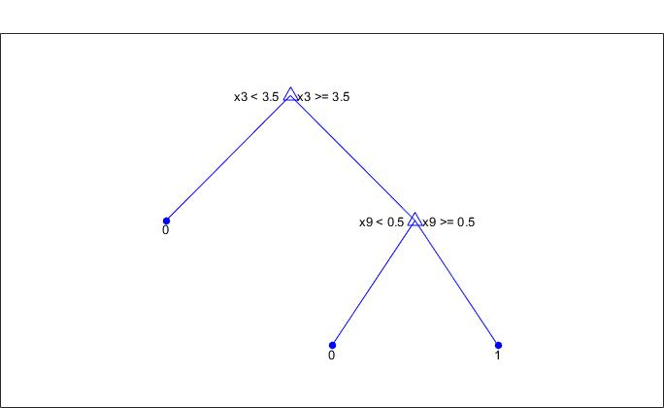
The Decision tree developed

Slide 17
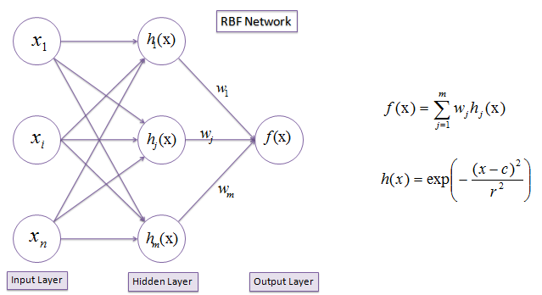
Radial Basis Network
Works by approximating functions
Approximation is done by iterative training on the given data
The error on the training data can be reduced to values as small as desired
New neurons can be added until the mean square error goal is achieved.

Slide 18
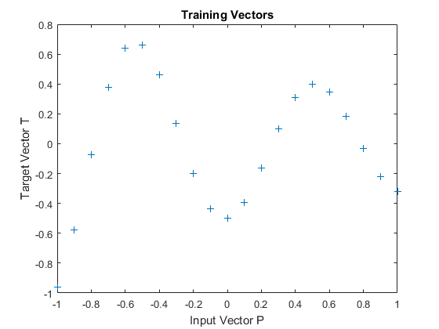
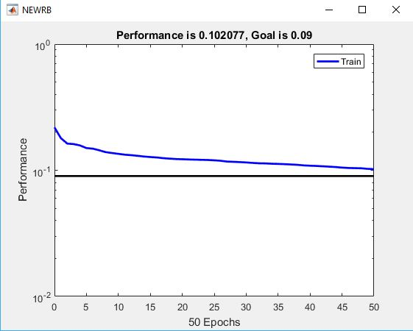
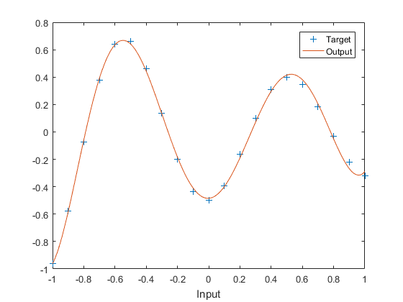
RBF Training

Slide 19
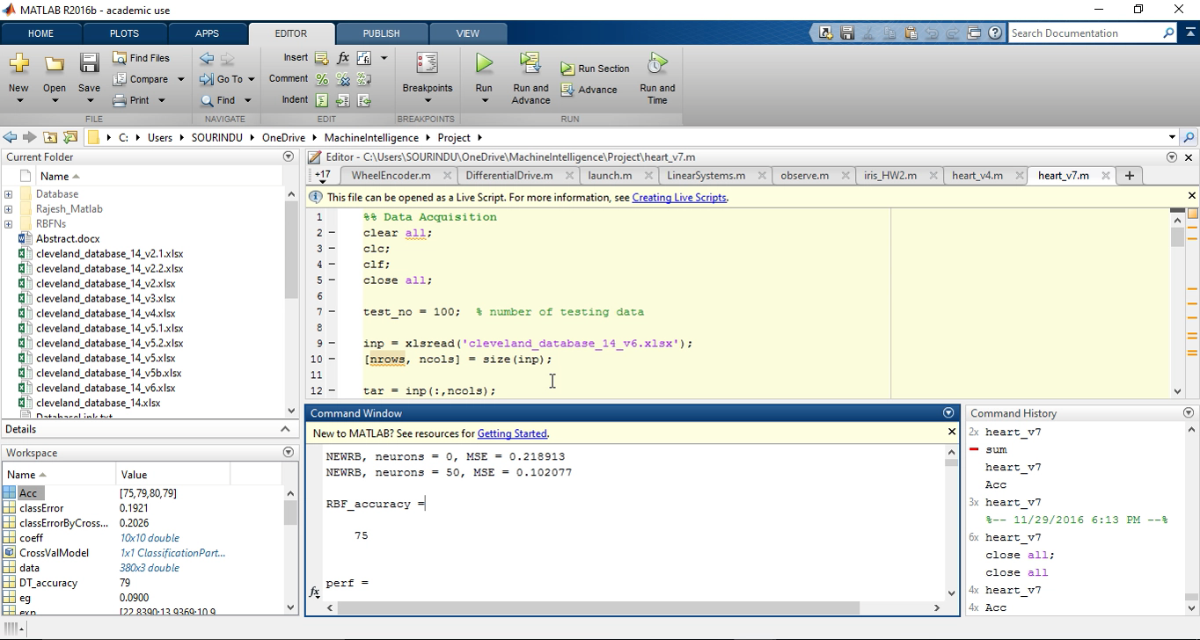
Code Video

Slide 20
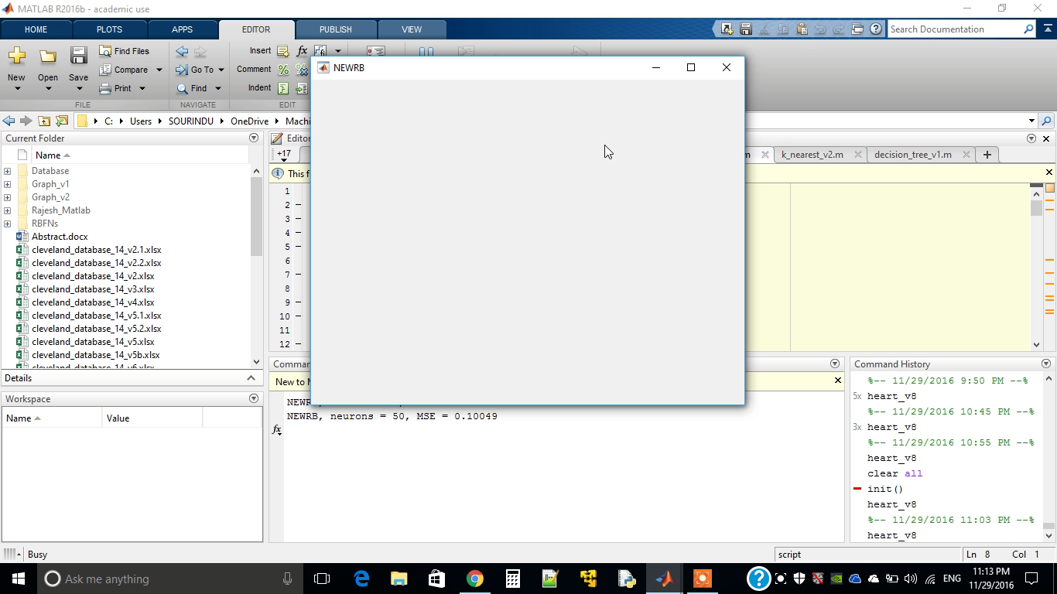
Training Video

Slide 21
Conclusion
The development for an effective weight function to be used in PCA is in progress.
The higher accuracy can be achieved using revised PCA to gain the maximum information.

Slide 22
Future Work
Use more number of attributes given in the UCI database
Apply the techniques used for a larger database
Create a reliable phone app for real-time use.

Slide 23
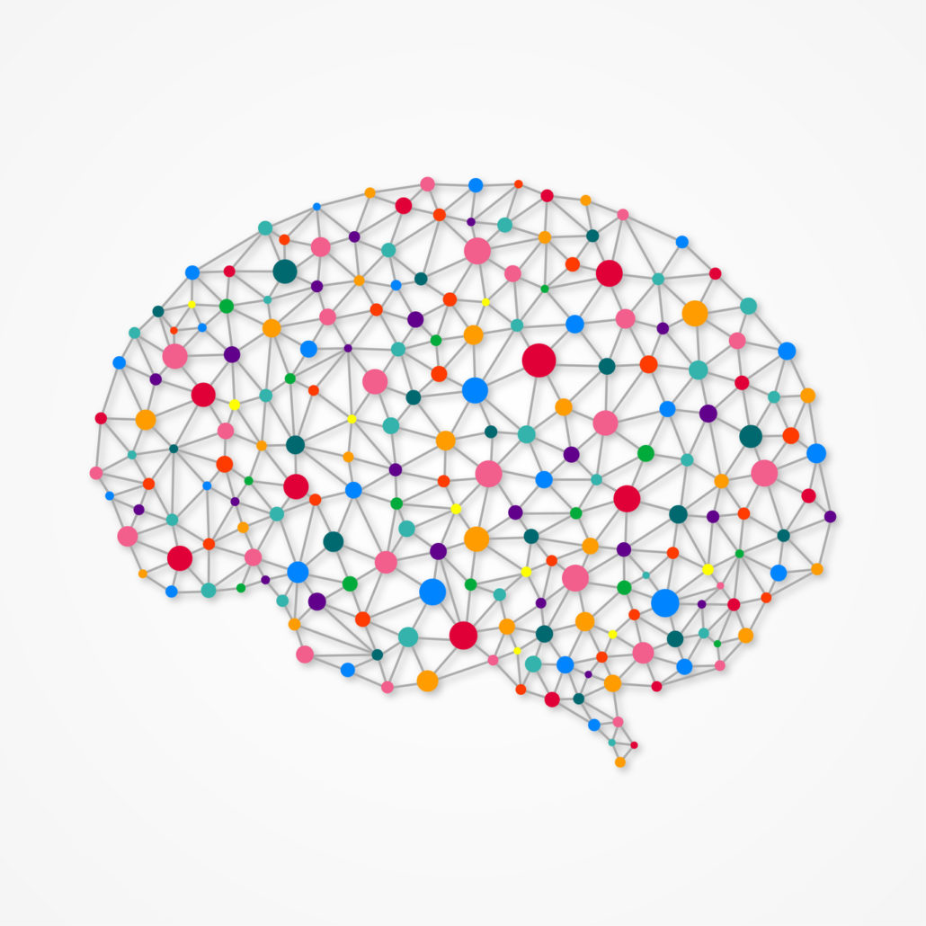
Questions?

